Slide 1

Clean Code
Notes:
#

Slide 2
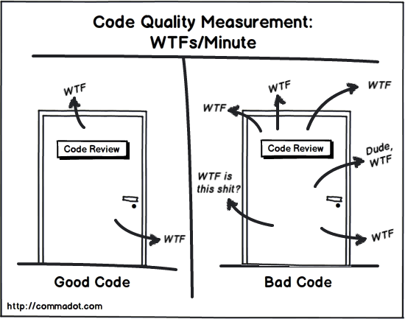
The only real Measurement for Code Quality

Slide 3
Code Smells
characteristics that possibly indicates deeper problems
code smells are not bugs
they indicate weeknesses in the programm
decrease development speed
depends on programming language
it is subjective what a code smell is and what is not

Slide 4
Code Smells - Examples
large classes
inappropriate intimacy
shotgun surgery
duplicated code
data clump
long methods

Slide 5
Why does Clean Code matter?
Productivity
desire to go fast ≠ Productivity
unclean additions make Code messier
new Features are implemented really fast (1 week), working on the same module one year later means headaches if code is unclean
Maintainance is easier
→ readability

Slide 6
What Clean Code is according to…
Kent Beck: „There is a fragile premise that good code matters“
Robert C. Martin: „The only way to go fast is to go well“
Grady Brooch: „Clean Code reads like well written prose“
Michael Feathers: „Clean Code looks like it was written by someone who cares“
Ward Cunningham: „You know you are working on Clean Code when each routine you read turns out to be pretty much what you expected“

Slide 7
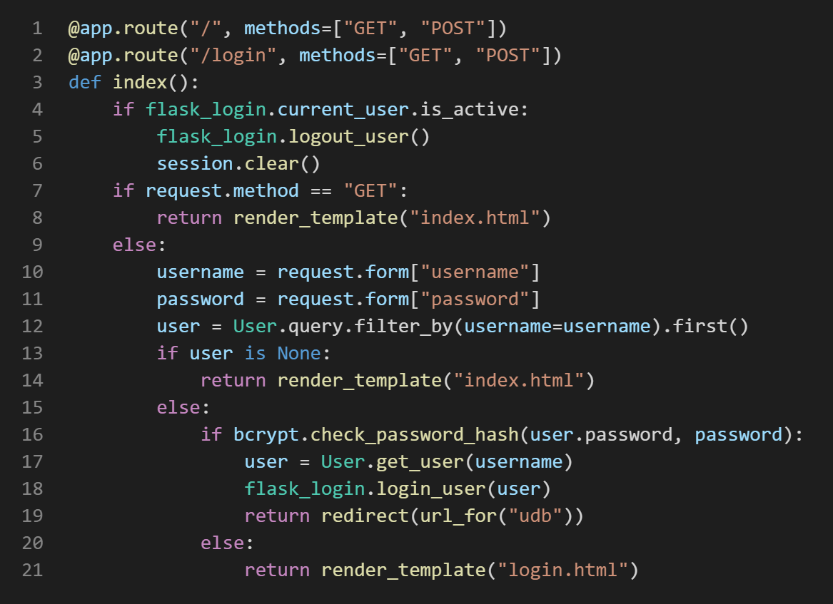
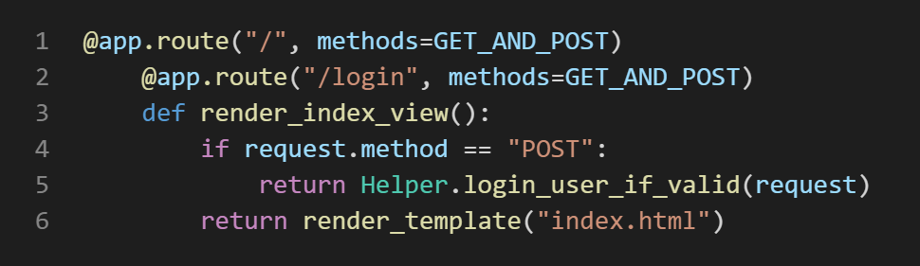

Slide 8
Functions should be small
each line at the same level of abstraction
easy to understand
polite → get out early
function should do one thing

Slide 9
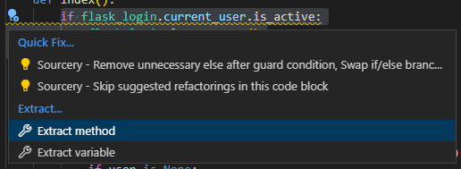
Functions should be small

Slide 10
More rules for functions
function should do one thing
extract methods
should NOT take more then 3-4 arguments
arguments are cohesive
use objects for cohesive arguments
mostly never pass booleans into a function
there must be an if-then-else
better: split branches into functions

Slide 11
Avoid switch statements
they do more then one thing
use polymorphism instead
potentially break with Open-Closed-Principle
they make it hard to independently deploy new modules
S
C C
C
C
C
Module A
Module B
Module C
Module D
Module S
Module E

Slide 12
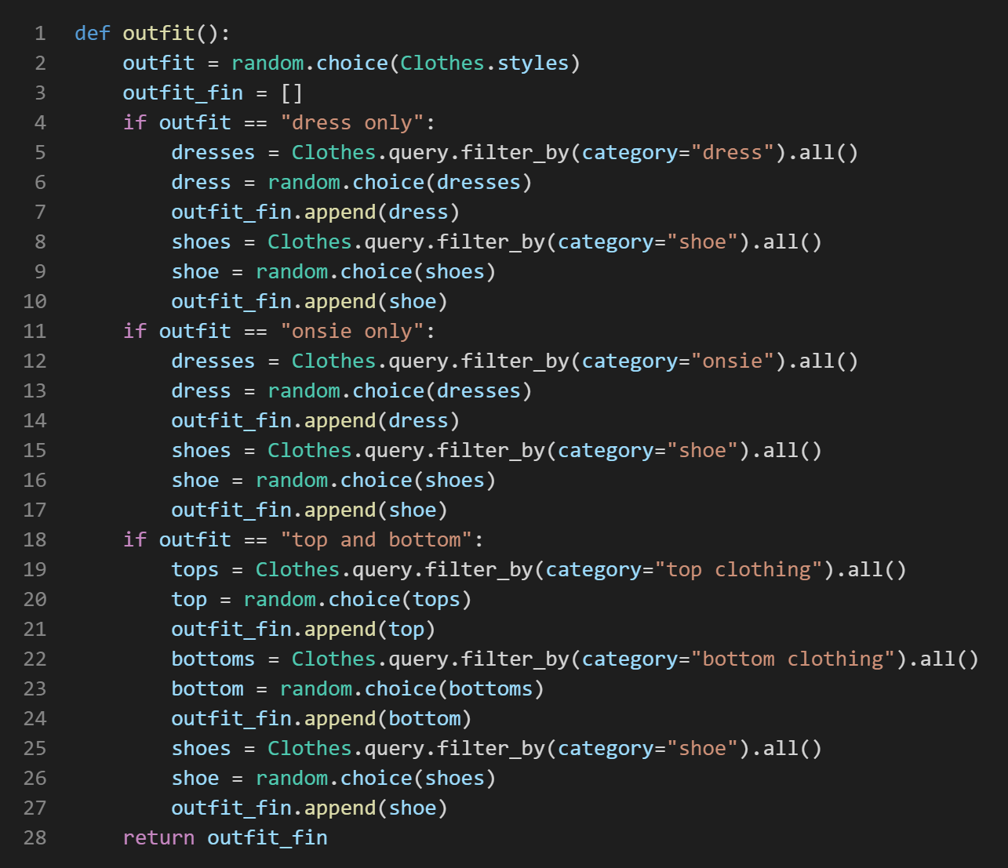
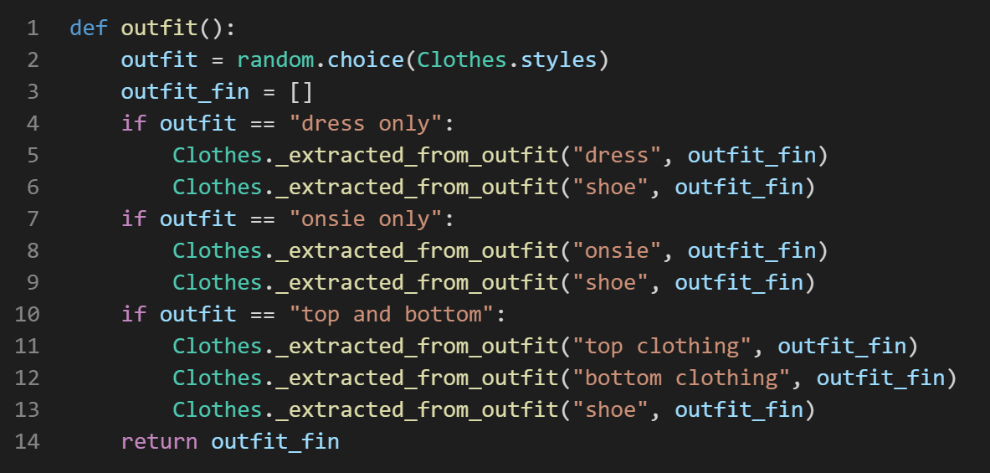
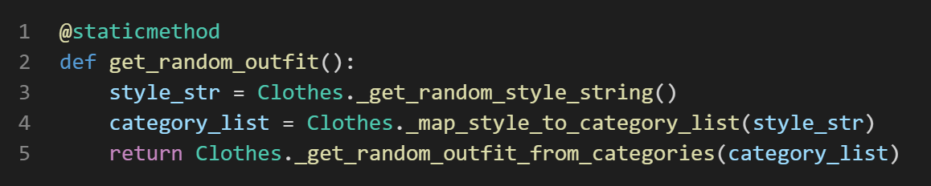
DRY – Don‘t repeat yourself

Slide 13
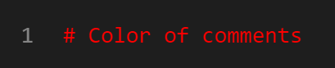
Comments
We write comments because we want others to read those comments.
Every comment is the failure to express yourself well in code.
Not everything can expressed in Code
Comments can be useful if they are good
Comments can be obscuring if they are bad
Be careful with usage of comments

Slide 14
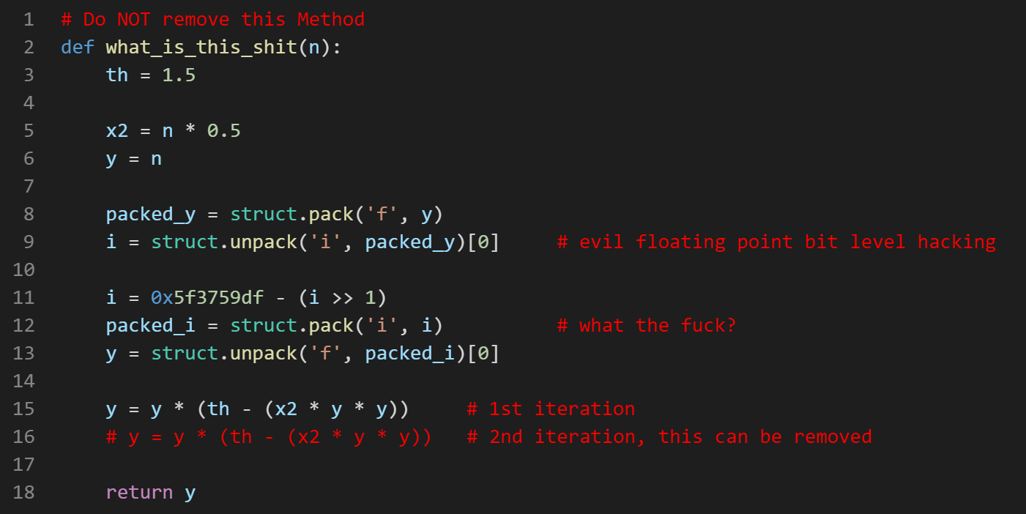
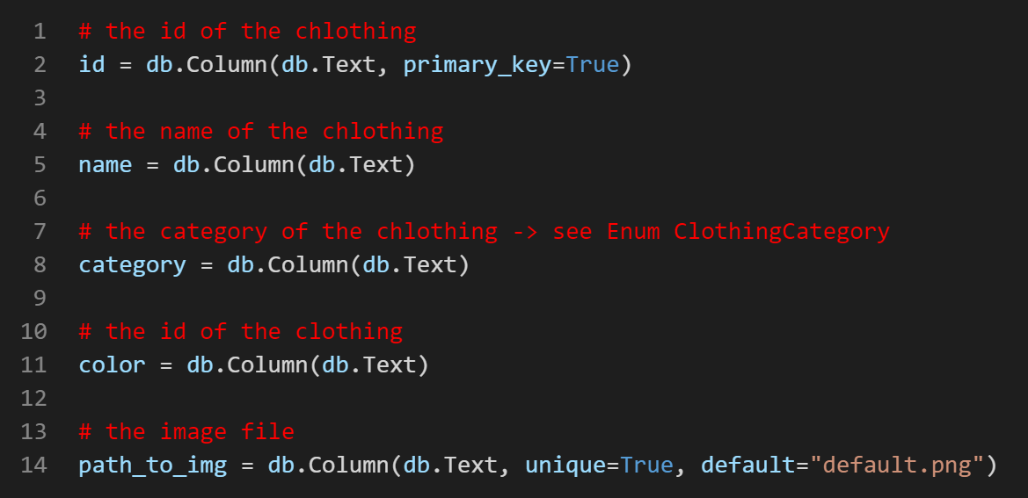
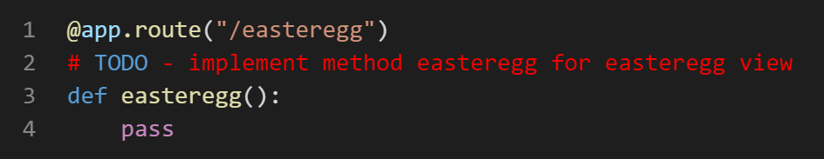
Some bad comments

Slide 15
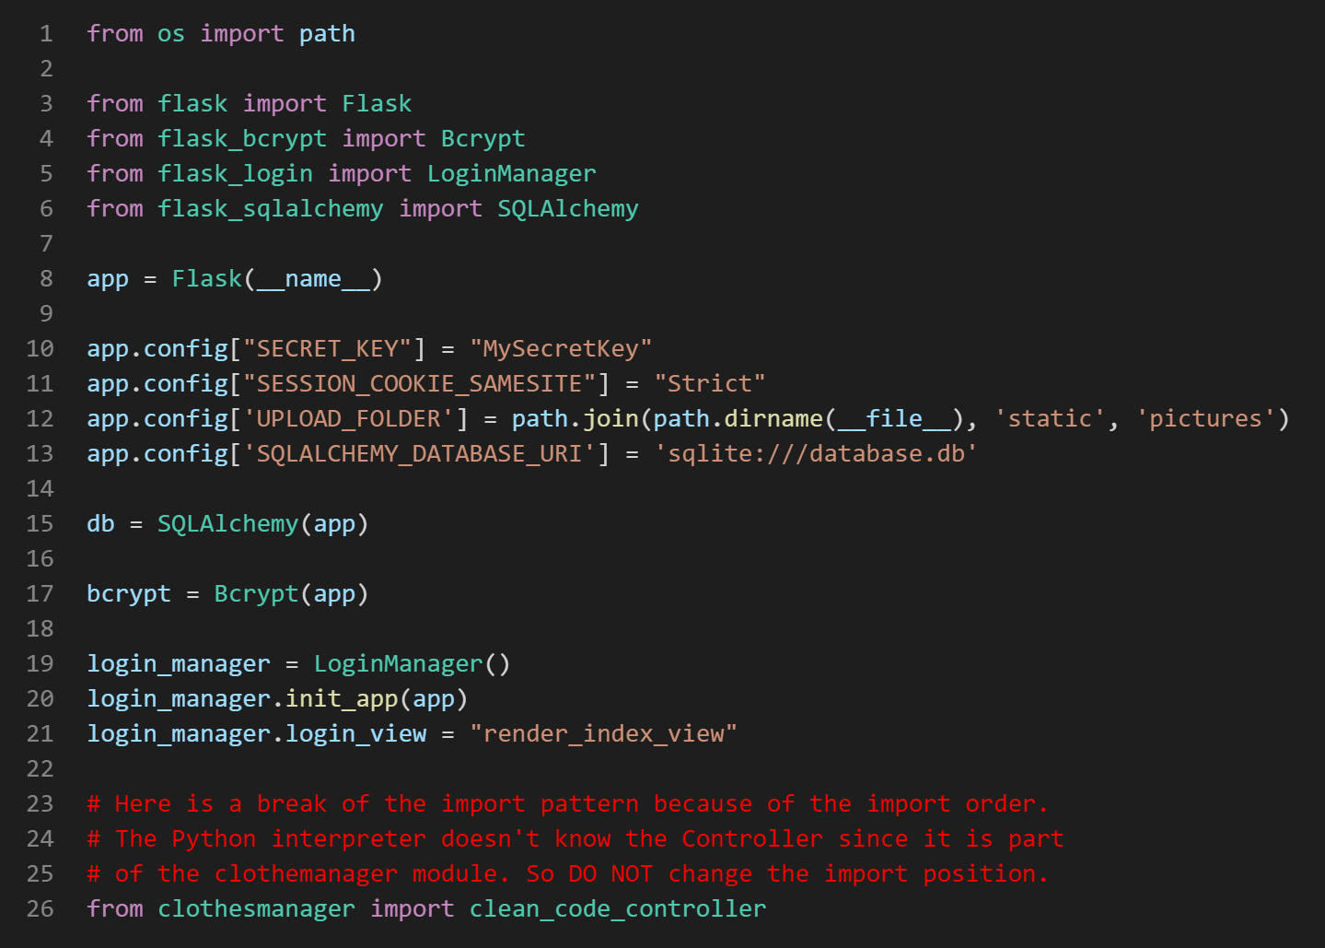
Good comment example

Slide 16
Names
Variables
The greater the scope the longer the name
Function
The smaller the scope the longer the name
should be a verb
Classes
Same as for variables
should describe the class

Slide 17
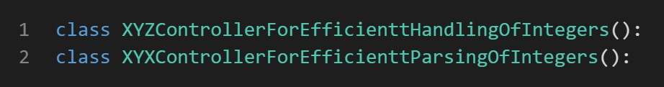
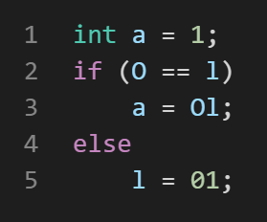
Names
Avoid optical illusions
Watch out for symbols

Slide 18
Formatting and Linting
Formatting:
rules different for every language
checks spacing, tabs, blanklines
code stays the same
Linting:
refactoring the code automatically
sorting imports
repositioning comments
uses the AST (abstract syntax tree)

Slide 19

Measurement

Slide 20
Stay clean, code clean

